Slide 1
Lecture 5 Measures of Location and Position

Slide 2
Review
1 A distribution has two clear peaks. What does that usually tell us?
The sample mixes two distinct sub-populations, picked out by some grouping variable.
2 What makes a distribution skewed?
A hard limit on the values – data pile up against the limit and trail away from it.
3 Name the two very different things an outlier can be.
A genuinely unusual observation, or a measurement or recording error.
4 Which plot(s) are best for large sample sizes, and which one(s) keep the actual data values?
The histogram for large n. The stem and leaf plot keeps the original values. Dot plot also – when applied to discrete data.

Slide 3
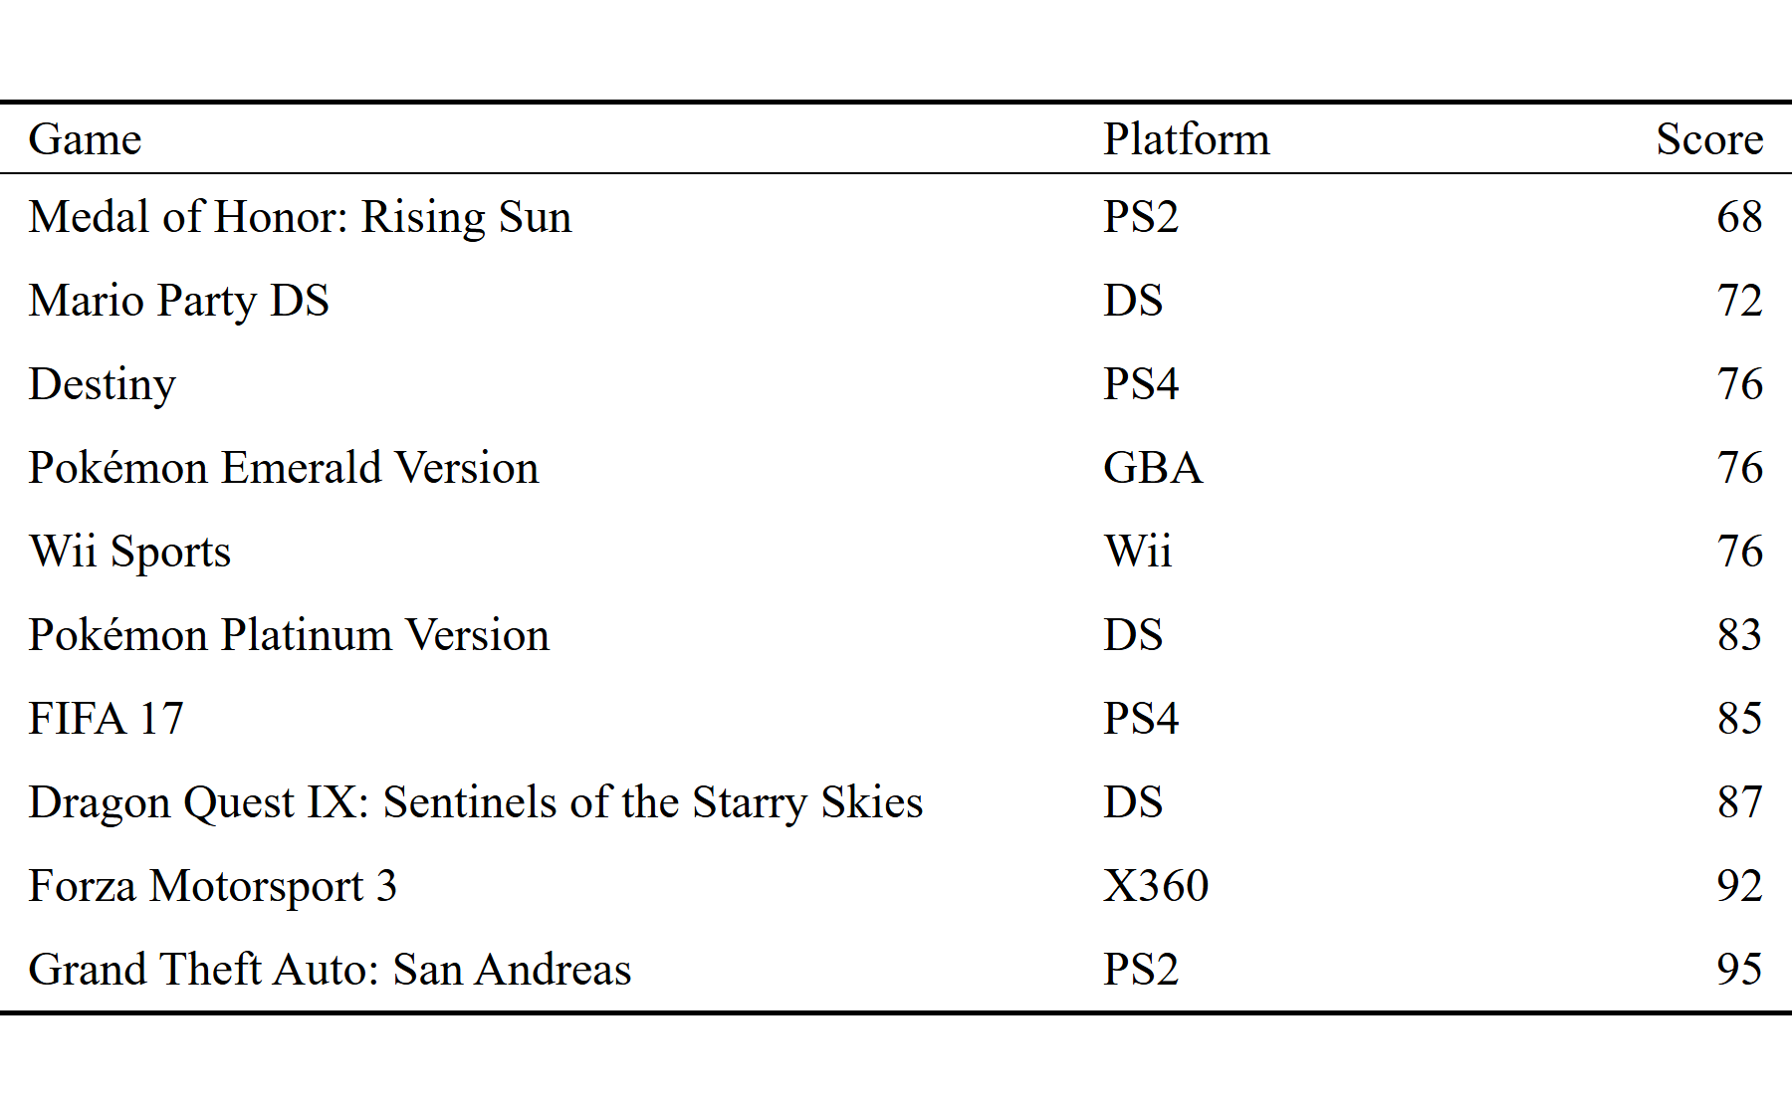
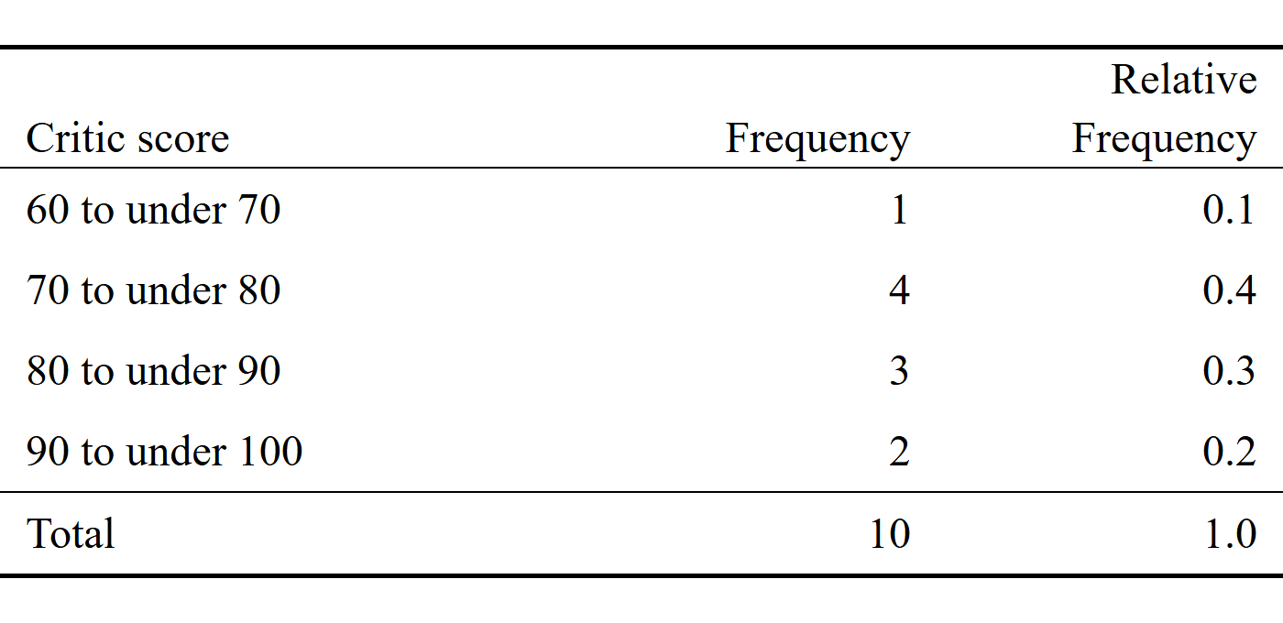
Review: ten video games
X = Metacritic critic score, for a random sample of n = 10 best-selling video games (circa 2000’s).
x = { 68, 72, 76, 76, 76, 83, 85, 87, 92, 95 }
Four bins of width 10. Most of these games score in the 70s, with a few running up into the 90s.
Data: VGChartz sales joined to Metacritic ratings, restricted to titles selling 5 million copies or more (127 games).

Slide 4

Measures of Central Tendency: the Mean
The (arithmetic) mean is the average value of a set of observations
it measures the center of mass of a distribution (the balancing point)
$\overline{x}= \frac{x_{1}+x_{2}+…+x_{n}}{n}= \sum_{i=1}^{n}{\frac{x_{i}}{n}}$
The population mean is also called the expected value, written E(X) or μ
the long-run average of the variable; the sample mean is our estimate of it
the mean is usually not equal to any of the values observed in the sample
The mean is highly influenced by outliers - observations that take on extreme values relative to the distribution

Slide 5
Practice: Calculate The Mean
$X=\{1, 3, 5, 5, 6, 7, 7, 8\}$

Slide 6
Alternative formulas for the mean
We can also express the mean in terms of the frequency $F$ or the relative frequency $RF$
$$\overline{x}=\frac{1}{n}\sum_{x}{x F(x)} or \overline{x}=\sum_{x}{x RF(x)}$$
Where the sum is over all distinct values of the variable $x$

Slide 7
Example: Computing the mean from a frequency table
X | Freq. | Rel. Freq
1 | 1 | 0.125
3 | 1 | 0.125
5 | 2 | 0.250
6 | 1 | 0.125
7 | 2 | 0.250
8 | 1 | 0.125
$$X=\{1, 3, 5, 5, 6, 7, 7, 8\}$$

Slide 8

Measures of Central Tendency: the Median
The median is the middle value of a set of observations
How to compute the median:
Compute the median by first ordering the observations from smallest value to largest value and choose the number in the middle
If the $n$ is odd the median is the middle number
- If $n$ is even the median is the sum of the two middle values divided by 2

Slide 9
Practice: Calculate the Median
$X=\{1, 3, 5, 5, 6, 7, 7, 8\}$

Slide 10
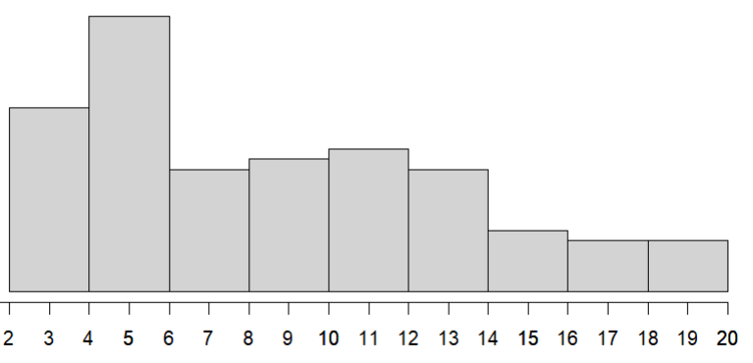
Data: 3 3 3 3 3 3 3 4 4 4 4 4 4 4 4 4 4 5 5 5 5 5 5 5 5 5 5
5 5 5 5 5 5 5 5 5 6 6 6 6 6 6 6 6 6 6 7 7 7 7 7 7 7 7
7 8 8 8 8 8 8 9 9 9 9 9 9 9 10 10 10 10 10 10 10 11 11 11 11 11 12
12 12 12 12 12 12 12 13 13 13 14 14 14 14 14 14 15 15 15 16 16 16 16 17 17 17 18
18 20 20 20 20 20
$$\overline{x}=9.2$$
$$median=\frac{8+8}{2}=8$$
The mean is the center of gravity
The median is the middle value

Slide 11
Mean and median treat outliers differently
$X=\{1, 3, 5, 5, 6, 7, 7, 8, 32\}$

Slide 12
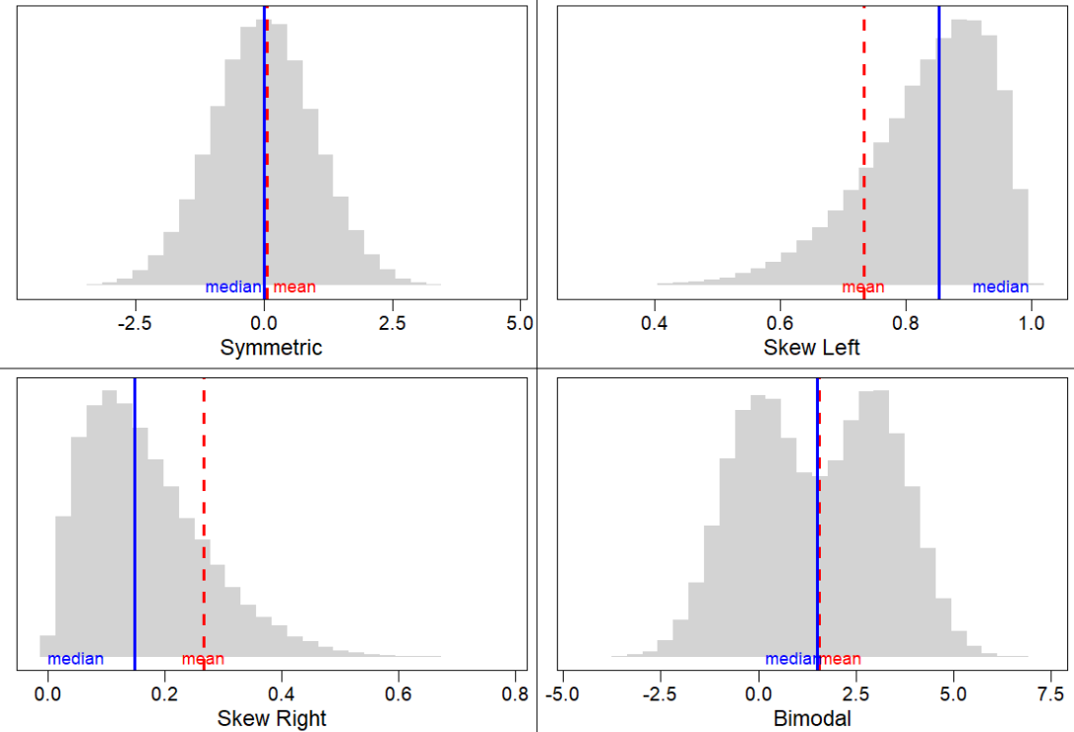

Slide 13
The mode
The mode is the value with the largest relative frequency (i.e the value that occurs most often)
Can be used with categorical data (mean and median cannot)
- e.g the most frequent category
It may not be unique if two or more values have the same frequency
Caution for quantitative data, the mode may not anywhere near the center of the distribution.
Ex.)
Data = 1,1,4,5,6
Mode = 1
Data = 1,1,4,5,6,6
Mode 1, 6

Slide 14
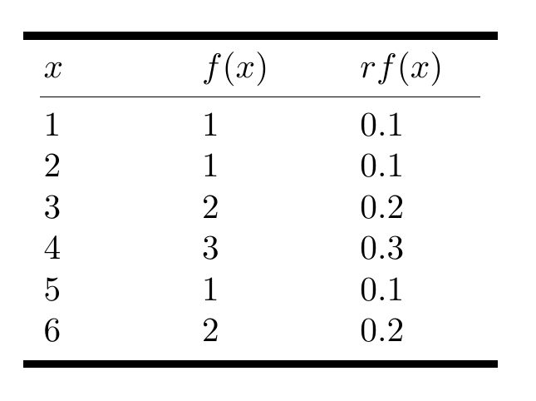
Practice 2:
Roll a six-sided die $n=10$ times and record the number rolled each time
Data = 1,2,3,3,4,4,4,5,6,6
Compute the mean using all 3 equations:
Compute the median
Compute the mode
Mean, three ways:
Σ x / n = 38 / 10 = 3.8
(1/n) Σ x· F(x) = (1· 1 + 2· 1 + 3· 2 + 4· 3 + 5· 1 + 6· 2) / 10 = 38 / 10 = 3.8
Σ x· RF(x) = 1(.1) + 2(.1) + 3(.2) + 4(.3) + 5(.1) + 6(.2) = 3.8
Median:
ordered 1 2 3 3 4 4 4 5 6 6
n is even, so median = (4 + 4) / 2 = 4
Mode:
4 appears three times, more than any other value → mode = 4

Slide 15

Measures of Location: Quartiles and Percentiles
The $p^{th}$ percentile is a value such that $p$ percent of the observations in a sample or population fall at or below that value
Ex. The 50th percentile is of any dataset is the median
Three useful percentiles of a distribution are the quartiles
The first quartile Q1 is the 25th percentile of the data.
The second quartile Q2 is the 50th percentile or median of the data.
The third quartile Q3 is the 75th percentile of the data.
The quartiles split a distribution in four equal parts each containing 25% of the observations

Slide 16
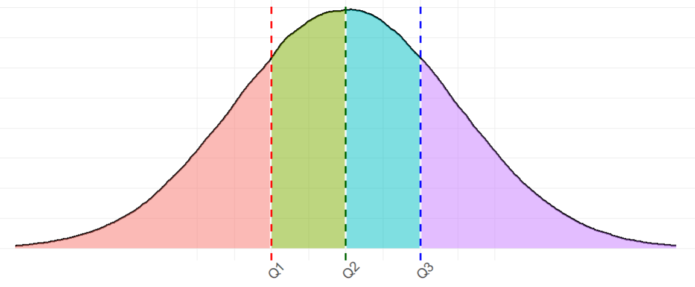
Measures of Position: Quartiles and Percentiles
Median
25%
50%
75%
25%
25%
25%
25%

Slide 17

Computing the Quartiles
How to compute the quartiles:
Arrange the data in increasing order
Find the median and label as Q2
Consider the lower half of the observations (excluding the median itself if $n$ is an odd number).
Mark the median for the lower half of the observations and label as Q1
Consider the upper half of the observations (again excluding the median itself if $n$ is odd)
Mark the median for the upper half of the observations and label as Q3

Slide 18
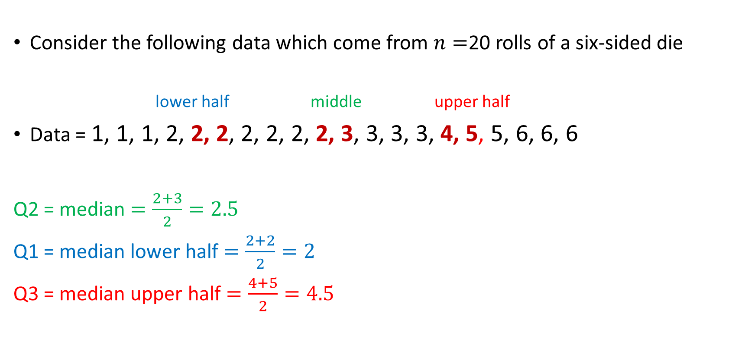
Ex. Quartiles
Consider the following data which come from $n=$20 rolls of a six-sided die
lower half middle upper half
Data = 1, 1, 1, 2, 2, 2, 2, 2, 2, 2, 3, 3, 3, 3, 4, 5, 5, 6, 6, 6
Q2 = median $=\frac{2+3}{2}=2.5$
Q1 = median lower half $=\frac{2+2}{2}=2$
Q3 = median upper half $=\frac{4+5}{2}=4.5$

Slide 19
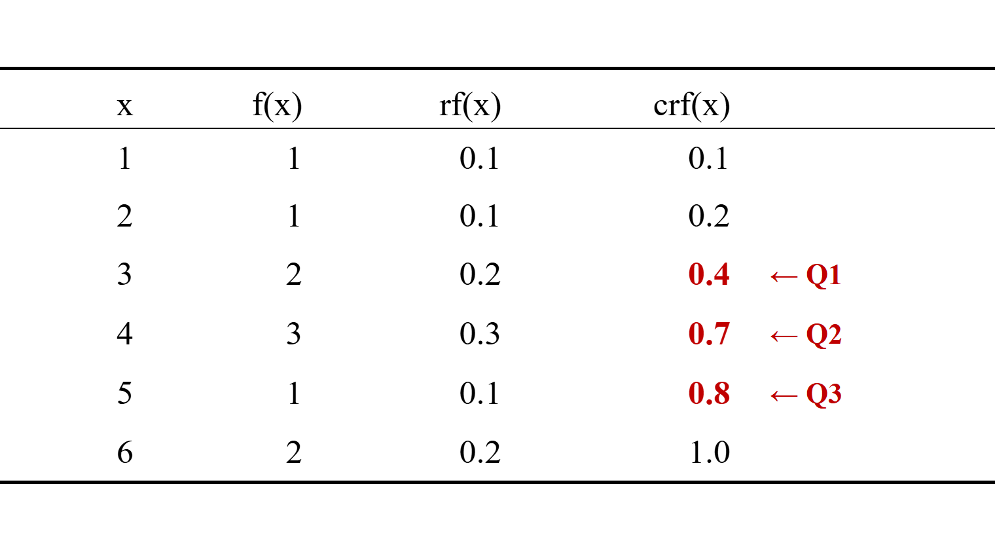
Quartiles from the cumulative relative frequency
The crf column says what fraction of the data falls at or below each value
So the percentiles can be read straight off the table
the pth percentile is the first value whose crf reaches p/100
Q1: first crf at or above 0.25 gives x = 3
Q2: first crf at or above 0.50 gives x = 4
Q3: first crf at or above 0.75 gives x = 5
The same Q1, Q2 and Q3 the halving method gave us
One caution: when a crf lands exactly on 0.25, 0.50 or 0.75, the two methods can differ by one step. Keep using the halving method as the definition; read the table to check yourself.

Slide 20
Practice: Quartiles from Exam Scores
Consider the following 15 exam scores of students in a statistics course
61,61,65,65,66,68,69,73,74,75,76,78,79,90,94
Compute the 3 quartiles Q1, Q2, and Q3

Slide 21
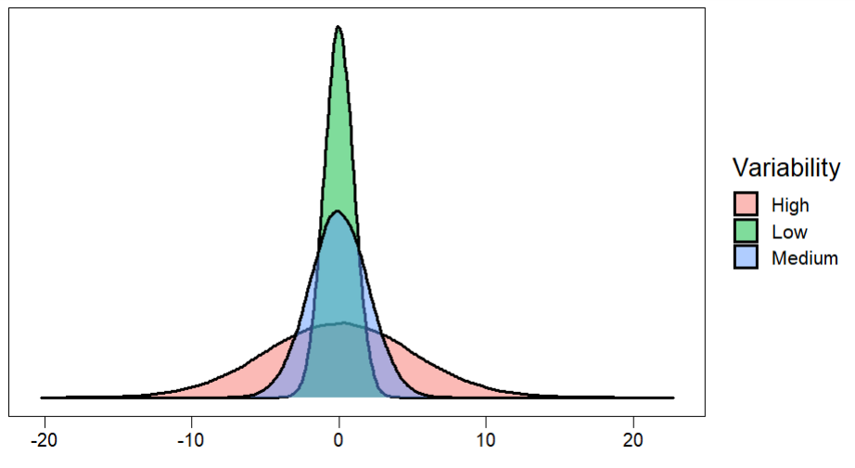
Variability of A Distribution: Measures of Spread

Slide 22
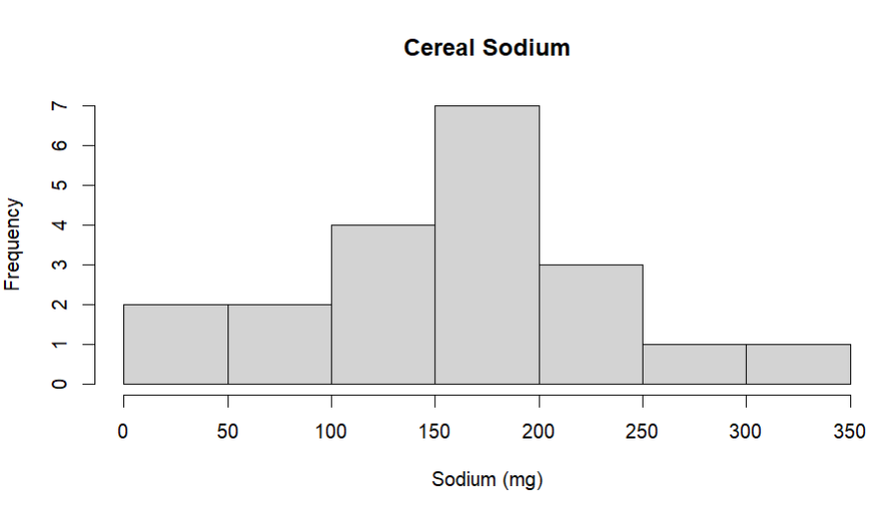
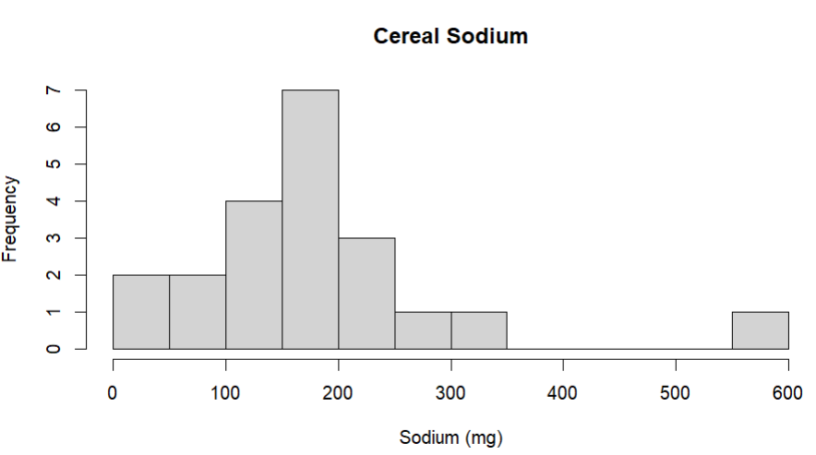
Measures of Spread: Range
The range is a measure of the distance between the smallest and largest values in the data
The range can be computed with only two data points the minimum value and maximum value
If the range of a set of data is large, then usually this indicates greater dispersion of values
The range is severely affected by the presence of outliers
We typically do not use the range to measure variability

Slide 23

Measures of Spread: Interquartile Range
The interquartile range (IQR) measures the spread of the middle 50% of the observations
It is resistant to outliers
$$IQR=Q3 −Q1$$
The more variability the larger the value of the IQR
IQR is a good choice for distributions that are highly skewed!

Slide 24
Practice: Finding quartiles and IQR
Exam Scores 61,61,65,65,66,68,69,73,74,75,76,78,79,90,94
Compute the IQR

Slide 25
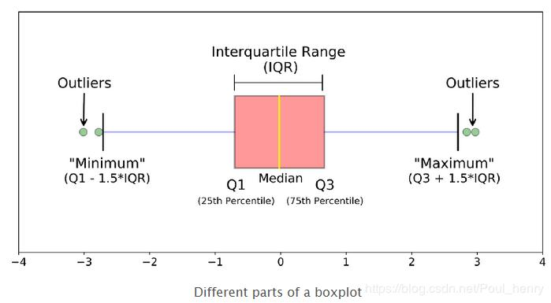
The Boxplot (Box and Whisker Plot): A five number summary
Pros:
good for describing shape and location
Can be used to identify outliers
Length of whiskers indicates skew
Good for comparing two distributions or across categories
Cons:
does not show certain features like mounds, or gaps as well as a histogram

Slide 26
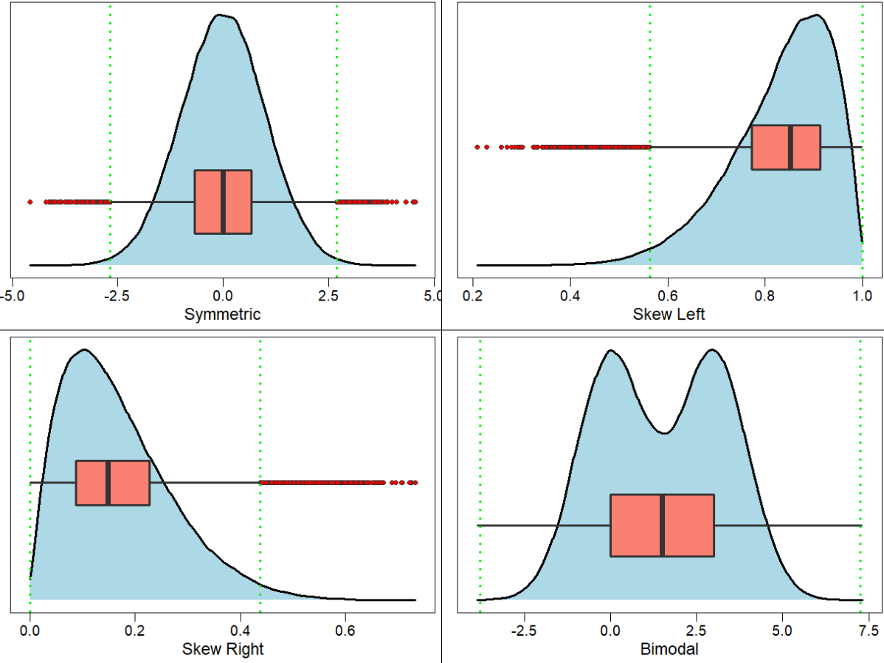

Slide 27

Ex. Construct a Boxplot
Consider the following data which come from 20 rolls of a six-sided die
lower half middle upper half
Data = 1, 1, 1, 2, 2, 2, 2, 2, 2, 2, 3, 3, 3, 3, 4, 5, 5, 6, 6, 6
Q2 = median $=\frac{2+3}{2}=2.5$
Q1 = median lower half $=\frac{2+2}{2}=2$
Q3 = median upper half $=\frac{4+5}{2}=4.5$

Slide 28
Practice: Construct a Boxplot
Construct the boxplot for student exam scores
Exam Scores 61,61,65,65,66,68,69,73,74,75,76,78,79,90,94

Slide 29
Ex2. Construct a Boxplot
Consider the following 12 observations of a quantitative variable X
X = { -5.7, -2.6, -1.5, -1.3, -0.4, 0.2, 1.5, 2.2, 2.3, 2.6, 2.9, 10.4 }
Compute the 5 number summary and draw a boxplot
Compare the IQR with the range

Slide 30

Measures of Spread: Deviation
A better measure of variability that uses all the data is based on deviations
deviations are the distances of each value from the mean of the data:
Deviation of an observation$x_{i}=(x_{i} −\overline{x})$
Every observation will have a deviation from the mean

Slide 31
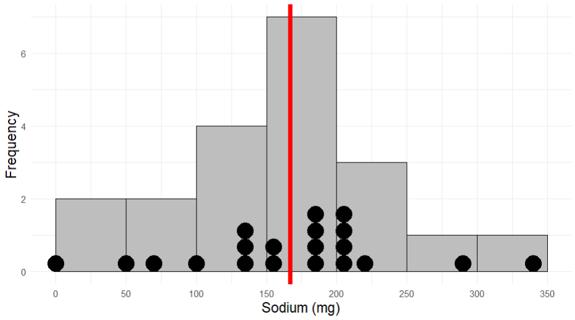
Frosted Mini Wheats = 0 (mg)
Mean = 167 (mg)
Rice Krispes = 340 (mg)
$$0 −167=−167$$
$$340 −167=173$$

Slide 32

Measures of Spread: Variance
The sum of all deviations is zero. $\sum_{i=1}^{n}{(x_{i} − \overline{x})}=0$
We typically use either the squared deviations or their absolute value
Squared deviation of an observation $x_{i}= {\left(x_{i}− \overline{x}\right)}^{2}$
The Variance of a distribution is the average squared deviation from the mean
$$S^{2}=\frac{1}{n−1}\sum_{i=1}^{n}{{\left(x_{i}−\overline{x}\right)}^{2}}$$
The sum $\sum_{i=1}^{n}{{\left(x_{i}−\overline{x}\right)}^{2}}$ is called the sum of squares

Slide 33
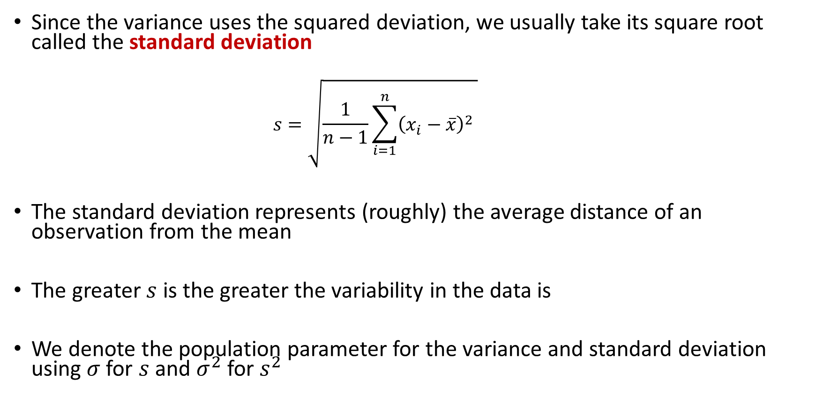
Measures of Spread: Standard Deviation
Since the variance uses the squared deviation, we usually take its square root called the standard deviation
$$s=\sqrt{\frac{1}{n−1}\sum_{i=1}^{n}{{\left(x_{i}−\overline{x}\right)}^{2}} }$$
The standard deviation represents (roughly) the average distance of an observation from the mean
The greater $s$ is the greater the variability in the data is
We denote the population parameter for the variance and standard deviation using $σ$ for $s$ and $σ^{2}$ for $s^{2}$

Slide 34

Why divide by $n−1$ ?
We divide by $n−1$ because we have only $n−1$pieces of independent information for $s^{2}$
Since the sum of the deviations must add to zero, then if we know the first $n−1$ deviations we can always figure out the last one
Ex.) suppose we have two data points and deviation of the first data point is $x −\overline{x}=−5$
Then the deviation of the second data point has to be 5 for the sum of deviations to be zero.

Slide 35
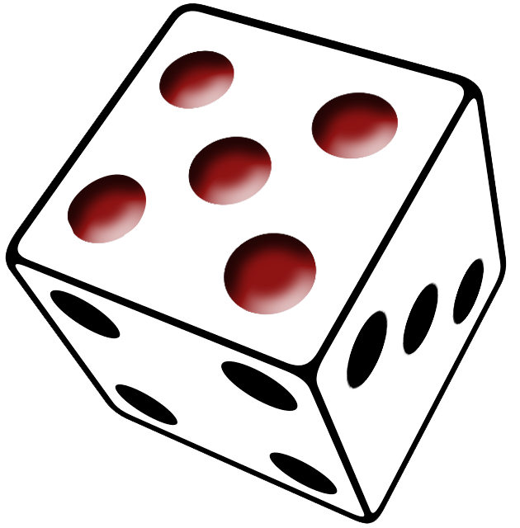
Try it out: Computing 𝑠 and 𝑠 2
Roll a six-sided die $n=10$ times and record the number rolled each time
Data = 1,2,3,3,4,4,4,5,6,6
Mean = 3.8

